Slide 1
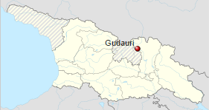

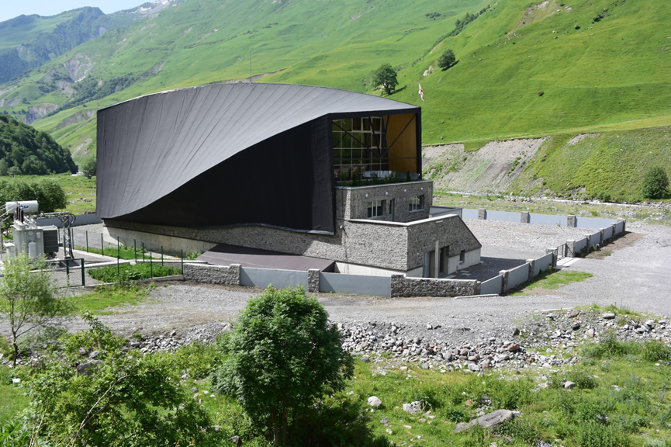
Energo-Aragvi LTD
3 Gotua Street,0160 Tbilisi
GEORGIA
info@energo-aragvi.ge
www.energo-aragvi.ge
G e o r g i a
Austrian and Georgian shareholders funding & operating small hydro power project in Caucasus mountains, Georgia
SHPP Gudauri, located about 100 km north to Tbilisi and close to Gudauri Ski resort presents its activities to reduce CO2 emission.
Hydropower plant Aragvi 1
Registration with UNFCC | 19.4.2013, Project Number 9079
Startup of electricity production | 3.2.2014
Yearly production | 50 mio. kwh
Installed capacity | 8 MW
Annual CO2 equivalent reduction | 22.891 metric tons
First monitoring report | 31.12.2013 – 31.10.2015
Issued certificates | 33.030 CO2 equiv. metric tons
3rd party verification | TÜV Süd

Slide 2
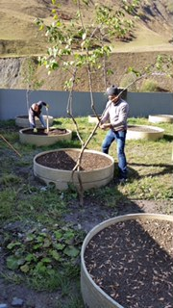
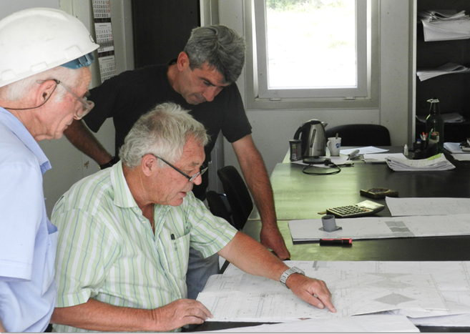
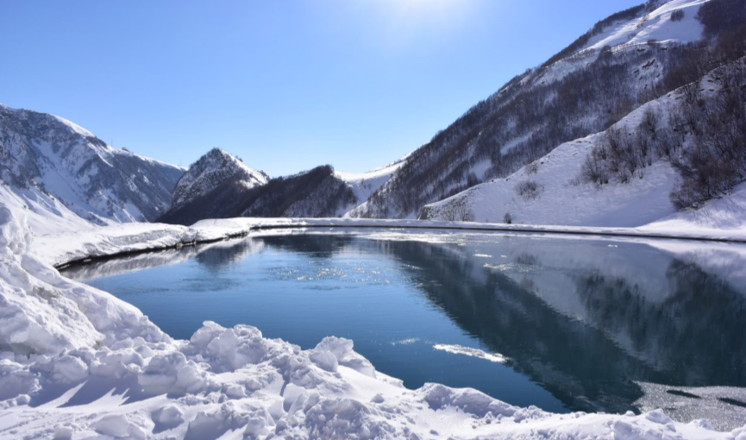
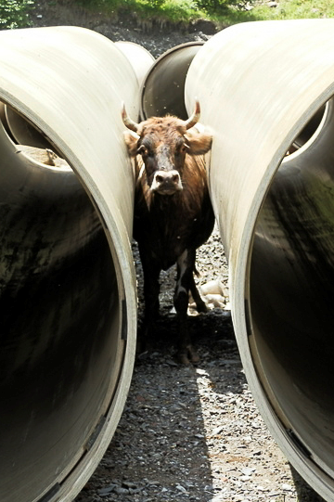
Clean energy production by using local river «Aragvi»
The Gudauri hydro power scheme was developed, financed and managed by
Georgian and Austrian shareholders. In addition it became registered at UNFCCC to create certified CO2 reduction to help financing special hydro power projects in Georgia.
Besides the production of clean renewable energy the project follows sustainable development, reforestation by own tree nursery, hydro grass seeding, river control structures against flood water events and water management by a balance reservoir.
Further Development, Aragvi 2
The extension to the existing project is under construction and will be finished 2018. Aragvi 2 will have an installed capacity of 1,9 MW and will produce about 13 to 15 mio. kWh p.a.
The project has been given the “Award Alliance” by ICPMA in June 2015
Tree nursery
Project Planning
Water reservoir in winter
local visitor

